Slide 1
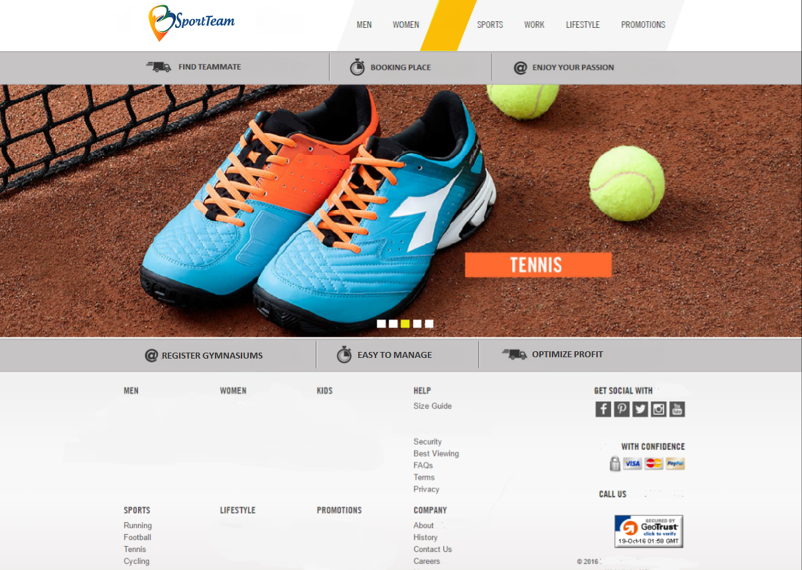
TeamSport
Own-Business
Email
Your email
Email
Your email
Password
Password
Password
Password
Re-Type
Password
Re-Type
Password

Slide 2
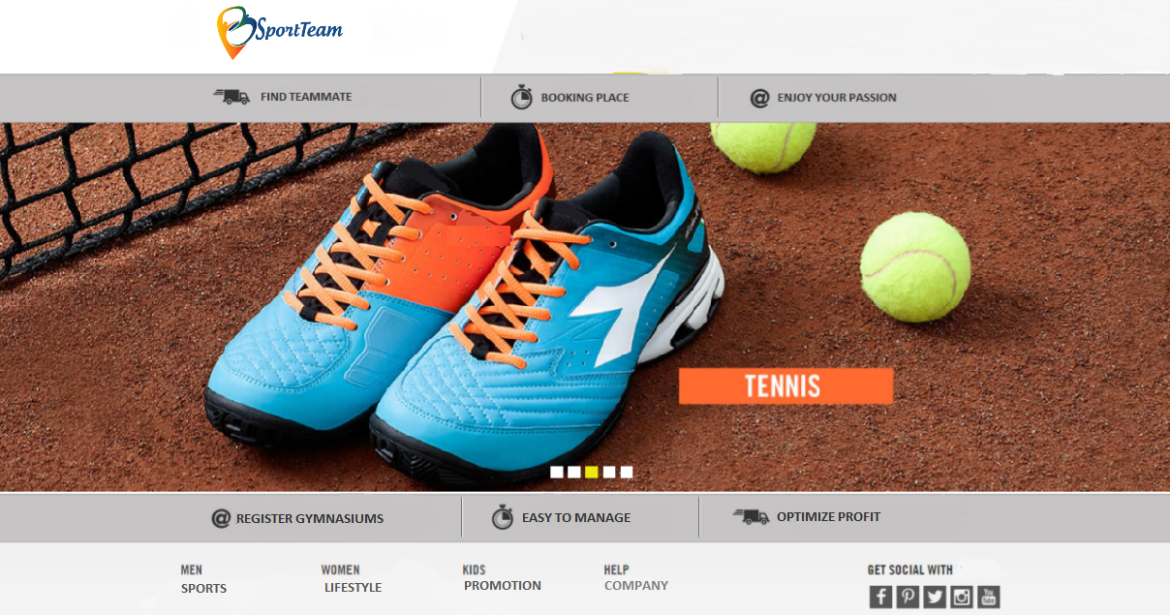
email
Your email
Pass
Your Password
Login
Sportteam
Own-Business
Email
Your email
Email
Your email
Password
Password
Password
Password
Re-Type
Password
Re-Type
Password

Slide 3
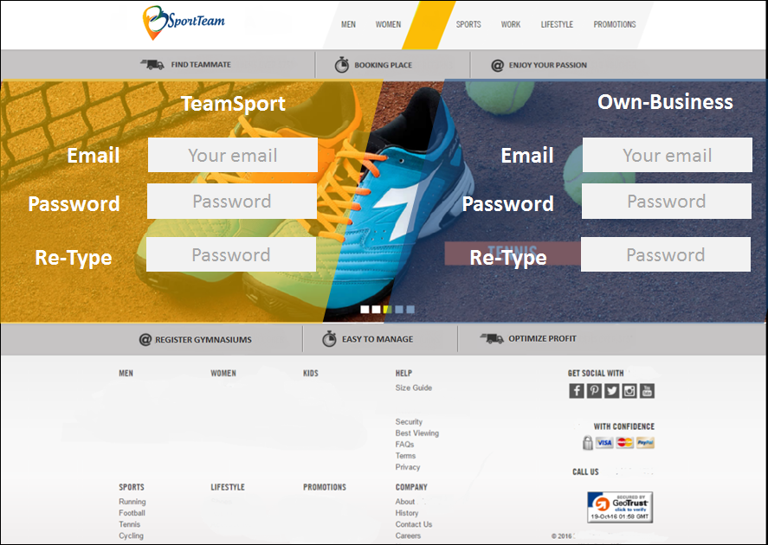

Slide 4
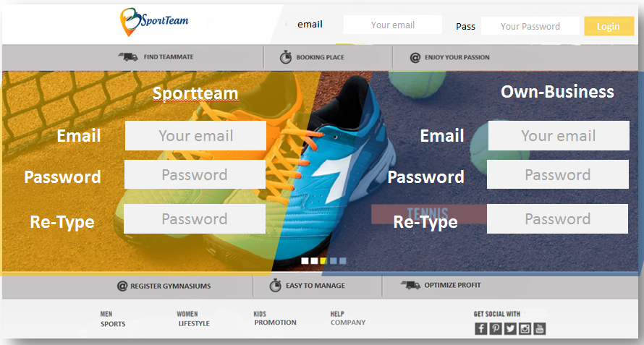

Slide 5



Log-in here
Email
Your email
Password
Password

Slide 6





Account
Home
TimeLine
Reviews
What’New
Bookings
Update your Status
Start your own-business
Photos
Videos
S1
S2
S3
S4

Slide 7
Account
Home
Events
TimeLine
Teams
Let’s Start
What’New
Sports
Update your Status
Start Booking to Play Sports
Bookings
Videos
Photos
Skills

